Slide 1
Sound Extras
Rich Davison

Slide 2
Global Audio
I made this fantastic (…) SoundSystem that can play 10s of sounds in 3D space during my MSc
  But it couldn't play global / GUI sounds!
    Global Sounds = Not in 3D space
Had to extend somewhat...
  SoundSystem has its own list of SoundEmitters
    Puts them at the listener's position every frame
    Deletes the SoundEmitter when sound has played
    Added to list by public SoundSystem functions
      SoundSystem::PlaySound(Sound*s, Vector3 at);

Slide 3
FreeList
While my current SoundSystem deletes these temporary nodes, there's another option you could try
  The Free list
  Instead of deleting a SoundEmitter when you're done with it, store it in a vector
  When you require a new one, don't 'new' it, get it from the free vector
  Only call 'new' if the freelist is empty
  Can preallocate a number of instances of an object in the free list if contiguous memory access is beneficial

Slide 4
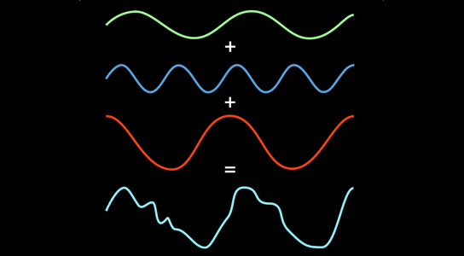
Audio Compression
Traditional compression (Huffman, RLE) not sufficient to PCM data
Fourier transform can turn sound wave into bands of sines and cosines
MP3 splits sound into
500+ bands, then
removes those that
human ear can't hear

Slide 5
Audio Compression
OpenAL only supports PCM 'out of the box'
  We need external libraries to turn formats into PCM
  MP3 has C libraries available, under a restrictive license (pay royalties over x units sold)
  Ogg Vorbis is completely free!
    Similar compression technique / ratio to MP3
    Library linked in to SoundSystem via OggSound class
    Who's read Discworld?
  Doesn't solve problem of large PCM data in memory!
  What can we do to avoid having lots of sound data in memory?!

Slide 6
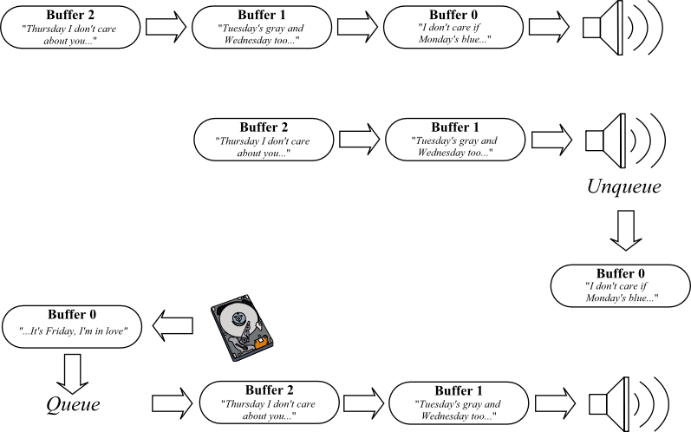
Audio streaming
Step 1:
Step 2:
Step 3:

Slide 7
Audio streaming
Step 1:
Step 2:
Step 3:

Slide 8
Cross Platform Audio
The provided code should work fine “out of the box” on Windows / Linux / Mac
  Minor API changes will get it on iOS too!
  What about Android and PS3?
  Both of these platforms will require a bit of extra work to produce sound using the provided classes
  Android is the easier of the two, we can use the OpenAL – Soft library
  PS3 is trickier – it has the MultiStream API, modelled on OpenAL

Slide 9
OpenAL - Soft
http://kcat.strangesoft.net/openal.html
  Software implementation of the OpenAL Spec
  Builds on top of a number of platform specific “Backends” - so very portable
  Version 1.15 onwards supports Android backend
  Comes as a source package, so you will need to build it, using the Android SDK toolchain
    You'll end up with a static library to link in to the android version of your game
  Once this is done, the API is otherwise identical, so the code should 'just work'

Slide 10
MultiStream
The PS3 has a few different audio APIs available
  'MultiStream' is broadly similar to OpenAL
  Is more complicated / feature complete
    Supports multiple listeners
    Advanced signal processing (EQ etc)
  The 'cellMSSurround' API functions behave like OpenAL
cellMSSurroundSourcef() = alSourcef
CELL_MS_SURROUND_GAIN = AL_GAIN
  PS3 documentation has MultiStream reference and Overview docs
  <SDK>\samples\sdk\sound\multistream\simple_surround

Slide 11
Cross Platform Development
Uh oh! Your code has to support (maybe) three different hardware platforms!
  What to do about shared codebase?
Do not be afraid of the C++ preprocessor
  We can hide platform specific code behind #IFDEF preprocessor statements
  You will have seen me use the preprocessor in the NCLGL library

Slide 12
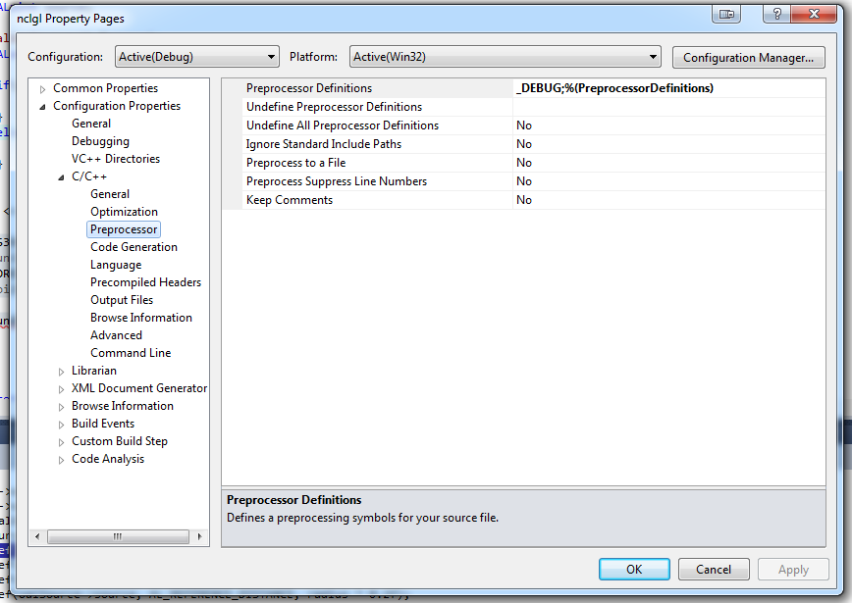
Cross Platform Development
#ifdef PS3VERSION
PSSoundInit();
#elif ANDROIDVERSION
AndroidSoundInit();
#else
PCSoundInit();
#endif

Slide 13
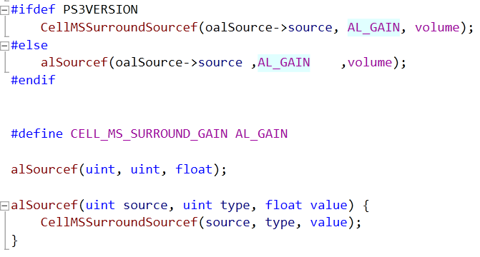
MultiStream
How best to integrate MultiStream into the SoundSystem class?
  Two ways we could go about it:

Slide 14
Conclusions
You now know how to add audio into your game!
  How sound is represented in binary data
  How to handle a limited number of resources
There was more to this workshop than audio!
  How to make a 'system' class cross-platform
  How to encapsulate API specific functionality behind a class
  How to keep track of the resources your game uses
  Classes should have a single responsibility

